Slide 1

Registration and Password Management
SoftUni Team
Technical Trainers
Software University
https://softuni.org

Slide 2
Table of Contents
Registration
Extending the User Model
Login/ Logout
Password Management
2
Notes:
2

Slide 3
Have a Question?
sli.do
#python-web
Notes:
3

Slide 4

Registration
Notes:
4

Slide 5
Registration
Django comes with a built-in user registration form
UserCreationForm
It connects to the pre-built model User
It comes with three fields
username
password1
password2

Slide 6
Using UserCreationForm (1)
Import the form and create a view as usual
from django.contrib.auth.forms import UserCreationForm
def create_profile_view(request):
if request.method == 'POST':
form = UserCreationForm(request.POST)
...
elif request.method == 'GET':
form = UserCreationForm()
...

Slide 7
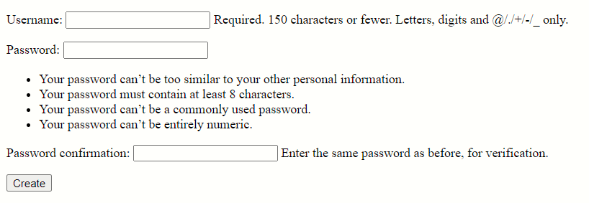
Using UserCreationForm (2)
Create a path and a template as usual
Start the development server

Slide 8
Custom Registration Form (1)
All User model fields could be used in a registration form
from django.contrib.auth.forms import UserCreationForm
from django.contrib.auth.models import User
class RegistrationForm(UserCreationForm):
email = models.EmailField(required=True)
class Meta:
model = User
fields = ('username', 'email', 'first_name', 'last_name',)
def save(self, commit=True):
# clean the data and save the user

Slide 9
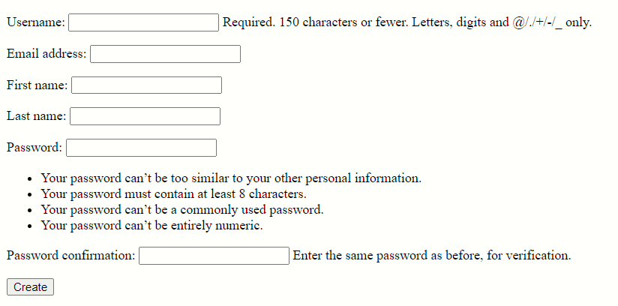
Custom Registration Form (2)
The fields are added to the form

Slide 10
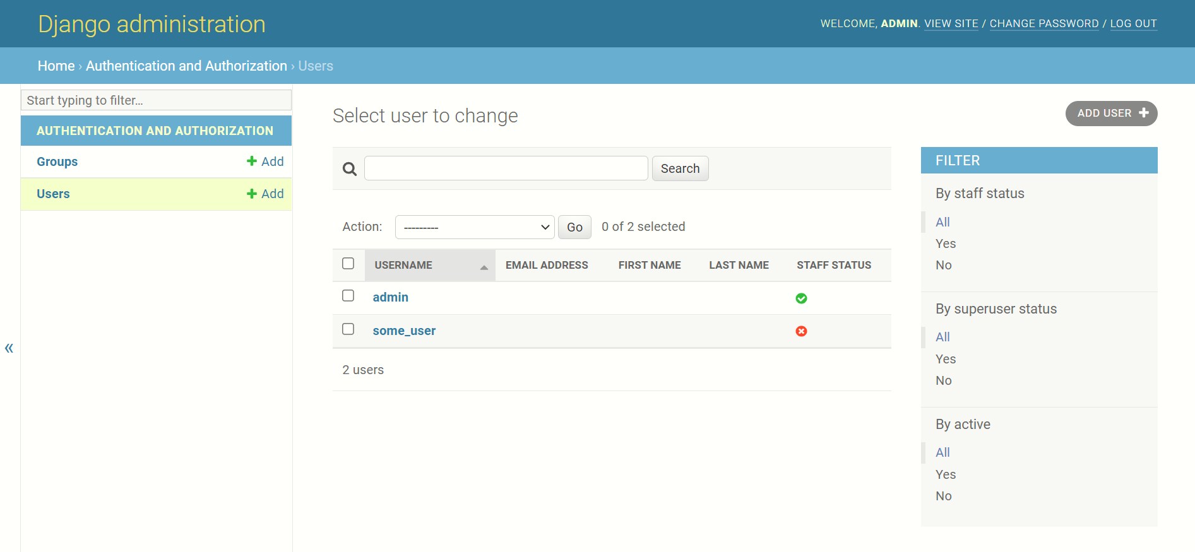
Users in the Admin Page
View the registered users in the admin page

Slide 11
Extending the Django User
Notes:
11

Slide 12
Extending the User Model
We often need to extend the Django User in our applications
Ways to extend the User model
Model inheritance without creating a new table
Having its own table with a One-To-One relationship with the existing User Model
Creating custom user extending the AbstractBaseUser
Creating new user model that inherit from AbstractUser

Slide 13
Model Inheritance (Using Proxy Model)
It is used to change the behavior of an existing model without affecting the existing database schema
e.g., add extra methods; add default ordering
from django.contrib.auth.models import User
class Person(User):
class Meta:
proxy = True
ordering = ('first_name', )
def some_behavior(self):...

Slide 14
Using One-to-One Relationship
It is used to store extra information about the existing User Model that is not related to the authentication process
from django.db import models
from django.contrib.auth.models import User
class Profile(models.Model):
user = models.OneToOneField(User, on_delete=models.CASCADE)
# add new fields

Slide 15
Extending the AbstractUser
Like the one-to-one relationship it is used to add some extra information
However, it directly makes the changes in the User model, without creating an extra class
Keep in mind that it dramatically impact the database schema
class CustomUser(AbstractUser):
# add extra fields
# update settings.py AUTH_USER_MODEL property

Slide 16
Extending the AbstractBaseUser
It is used when the app have specific requirements in relation to the authentication process
Keep in mind that it dramatically impact the database schema
from django.contrib.auth.models import PermissionsMixin
from django.contrib.auth.base_user import AbstractBaseUser
class CustomUser(AbstractBaseUser, PermissionsMixin):
# create the class similar to the build-in User Model
# pay attention to all objects related like Manager, etc.

Slide 17

Login/Logout
Notes:
17

Slide 18
Built-in Views
Once a user is registered, we want to make sure that they can log in and out of the site
Django provides class-based views that you can use:
LoginView
LogoutView
They use the built-in authentication forms, but you can pass in your own forms
Django provides no default template for the authentication views

Slide 19
Creating a Login System (1)
To use most of the provided Django authentication system, include the provided URLconf in your own URLconf
Or you can directly use the view in your URLconf
urlpatterns = [
path('accounts/', include('django.contrib.auth.urls')),
]
from django.contrib.auth import views
urlpatterns = [
path('sign-in/', views.LoginView.as_view()),
]

Slide 20
Creating a Login System (2)
If needed, you can easily extend or customize the views by subclassing them
Requests are redirected after login to '/accounts/profile/'
Change it by adding LOGIN_REDIRECT_URL to the settings.py
from django.contrib.auth.views import LoginView
class CustomLoginView(LoginView):
# extending or customizing the view

Slide 21
Creating a Login System (3)
Using the LoginView the created template gets passed four template context variables
form - a Form object representing the AuthenticationForm
next - the URL to redirect to after successful login
site - the current Site, according to the SITE_ID setting
site_name - an alias for site.name

Slide 22
Creating a Logout System
It is like when using LoginView
Differences:
Add LOGOUT_REDIRECT_URL to the settings.py
Template context variables
title - the string "Logged out"
site - the current Site, according to the SITE_ID setting
site_name - an alias for site.name

Slide 23
logout_then_login
Logs a user out, then redirects to the login page
login_url - optional argument, defaults to settings.LOGIN_URL
<body>
<form method="post"
action="{% url django.contrib.auth.views.logout_then_login %}">
{% csrf_token %}
<input type="submit" value="Logout" />
</form>
</body>

Slide 24
redirect_to_login
Redirects to the login page, and then back to another URL after a successful login
Arguments
next - required; the URL to redirect to after a successful login
login_url - optional; defaults to LOGIN_URL if not supplied
redirect_field_name - optional; the name of a GET field containing the URL to redirect to after log out
Overrides next if the given GET parameter is passed

Slide 25

Password Management

Slide 26
Password Management
Django provides a secure and flexible set of tools for managing user passwords
It should not be reinvented unnecessarily
It uses the PBKDF2 algorithm with a SHA256 hash
Quite secure, requiring massive amounts of computing time to break

Slide 27
Hashing
For security reasons, the passwords should be stored in a hashed form
This guards against unauthorized access to the database
Hashing performs a one-way transformation on a password, turning it into another string, called hashed password
It is practically impossible to turn the hashed password back into the original password

Slide 28
Default PASSWORD_HASHERS
PASSWORD_HASHERS = [
'django.contrib.auth.hashers.PBKDF2PasswordHasher',
'django.contrib.auth.hashers.PBKDF2SHA1PasswordHasher',
'django.contrib.auth.hashers.Argon2PasswordHasher',
'django.contrib.auth.hashers.BCryptSHA256PasswordHasher',
'django.contrib.auth.hashers.ScryptPasswordHasher',
]

Slide 29
Hashing While Testing
The default password hasher is rather slow by design
When authenticating many users in tests, you may want to use a custom settings file and set the PASSWORD_HASHERS setting to a faster hashing algorithm
PASSWORD_HASHERS = [
'django.contrib.auth.hashers.MD5PasswordHasher',
]

Slide 30
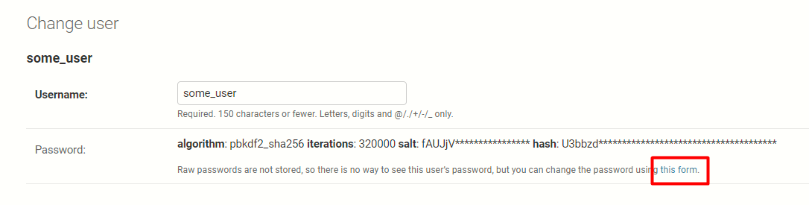
Set Password
set_password(raw_password)
User model method
Sets the user's password to the given raw string, taking care of the password hashing (doesn't save the User object)
Set password using the admin page

Slide 31
Other User Model Password Methods
check_password(raw_password)
Returns True if the given raw string is the correct password for the user (takes care of the password hashing)
set_unusable_password()
Marks the user as having no password set (not blank string)
has_usable_password()
returns False if set_unusable_password() has been called

Slide 32
Password Views
Django auth system comes with a list of views you can use
PasswordChangeView
PasswordChangeDoneView
PasswordResetView
PasswordResetDoneView
PasswordResetConfirmView
PasswordResetCompleteView
Documentation: https://docs.djangoproject.com/en/4.0/topics/auth/default/#django.contrib.auth.views.PasswordChangeView

Slide 33
Password Forms
Django auth system comes with a list of forms you can use
PasswordChangeForm
PasswordResetForm
SetPasswordForm
Documentation: https://docs.djangoproject.com/en/4.0/topics/auth/default/#module-django.contrib.auth.forms

Slide 34
Password Validation
Django offers pluggable password validation
A few validators are included in Django, but you can write your own
AUTH_PASSWORD_VALIDATORS = [
{'NAME': '...UserAttributeSimilarityValidator',},
{'NAME': '...MinimumLengthValidator',},
{'NAME': '...CommonPasswordValidator',},
{'NAME':'...NumericPasswordValidator',},
]

Slide 35
Custom Password Validators
Must implement two methods
validate(self, password, user=None)
Validate a password
Return None if the password is valid
Raise a ValidationError with an error message if the password is not valid
get_help_text()
Provide a help text to explain the requirements to the user

Slide 36

Exercise
Practicing Register, Login, Logout

Slide 37

Summary
The authentication that comes with Django is good enough for most common cases, but you may have needs not met by the out-of-the-box defaults
Customizing authentication in your projects requires understanding what points of the provided system are extensible or replaceable
Notes:
37

Slide 38
Questions?
Notes:
38

Slide 39













SoftUni Diamond Partners

Slide 40


Educational Partners

Slide 41

License
This course (slides, examples, demos, exercises, homework, documents, videos and other assets) is copyrighted content
Unauthorized copy, reproduction or use is illegal
© SoftUni – https://softuni.org
© Software University – https://softuni.bg
Notes:
41

Slide 42
Trainings @ Software University (SoftUni)
Software University – High-Quality Education, Profession and Job for Software Developers
softuni.bg, softuni.org
Software University Foundation
softuni.foundation
Software University @ Facebook
facebook.com/SoftwareUniversity
Software University Forums
forum.softuni.bg
Notes:
42

